Slide 1

Campus Chatbot for Chanakya University
Provides campus info, directions, and FAQs viachat.
Built with Python, PyQt5, SQLite, and Leaflet maps.
Which also shows the maps of path from blocks to blocks

Slide 2
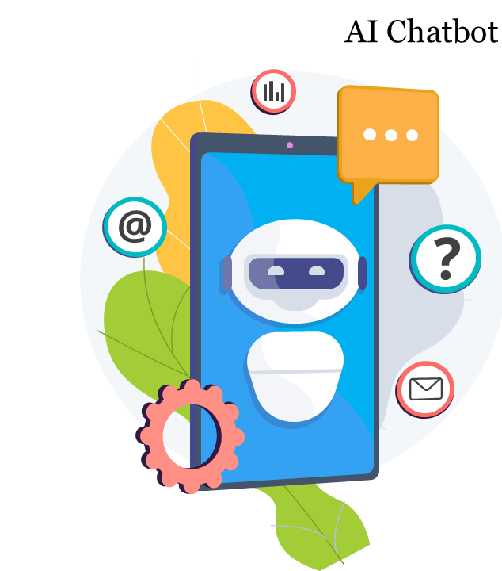
Problem Statement & Objectives
Problem: Difficulties navigating campus & accessing info quickly for vistors and freshers.
Objectives:
>Interactive chatbot for campus guidance
>Answers FAQs and shows directions
>User-friendly interface

Slide 3
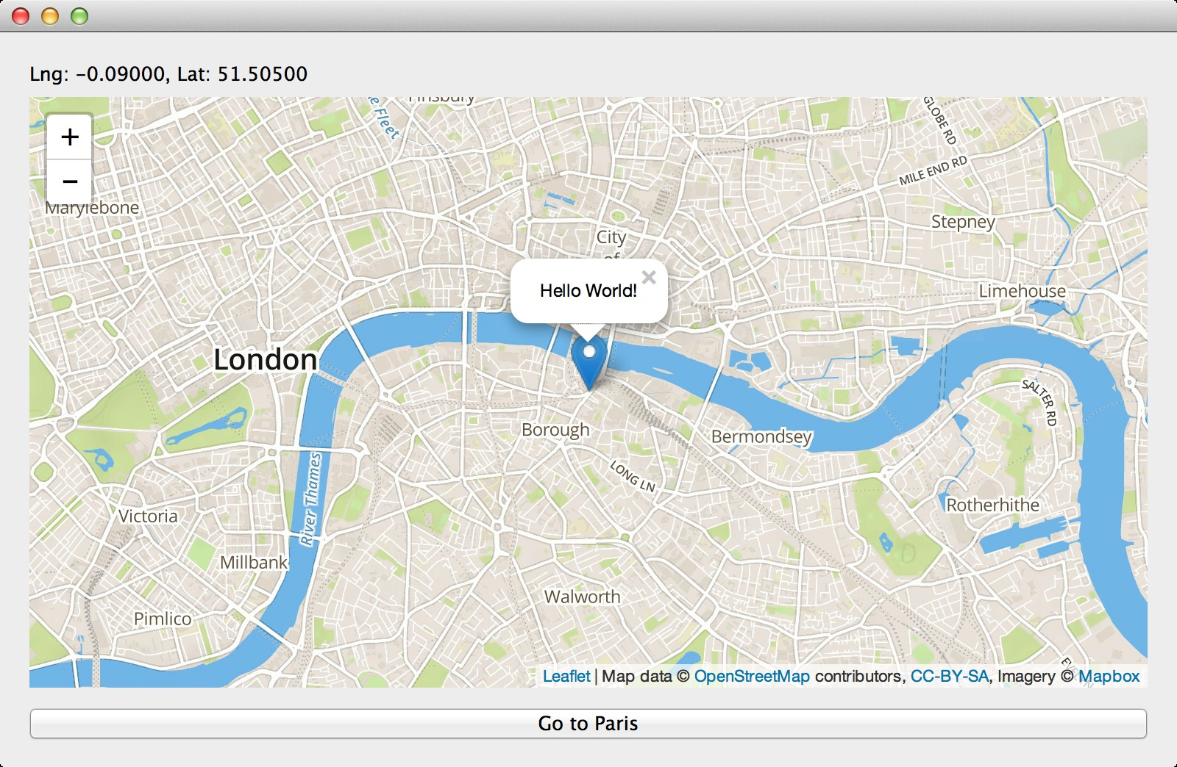
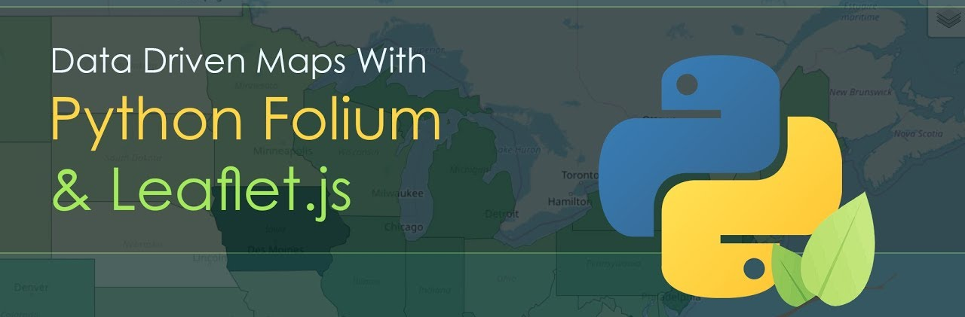
Tools & Technologies
Python 3, PyQt5 for UI
SQLite for data storage
Leaflet.js (via QWebEngineView) for map visualization
Libraries: difflib (autocorrect), deque (pathfinding)

Slide 4
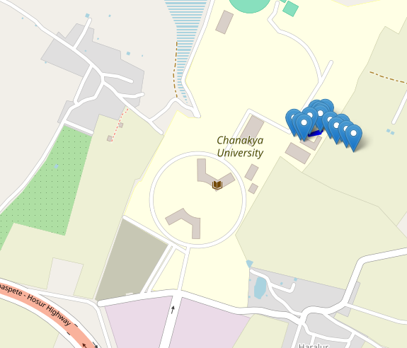
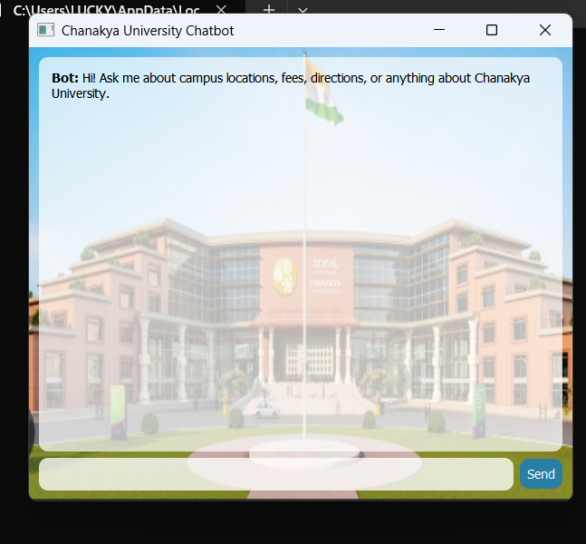
System Architecture
User interacts with UI → Backend processes queries
Database stores campus info
Navigation module finds shortest path
Map rendered in embedded web view
Architecture: UI → Backend → Database → Map rendering• Embedded interactive map with route visualization

Slide 5
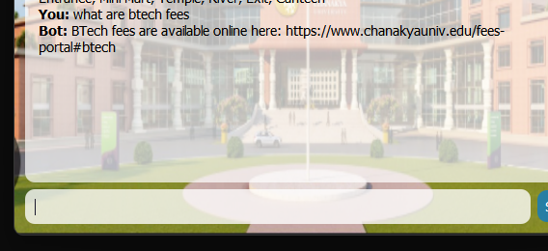
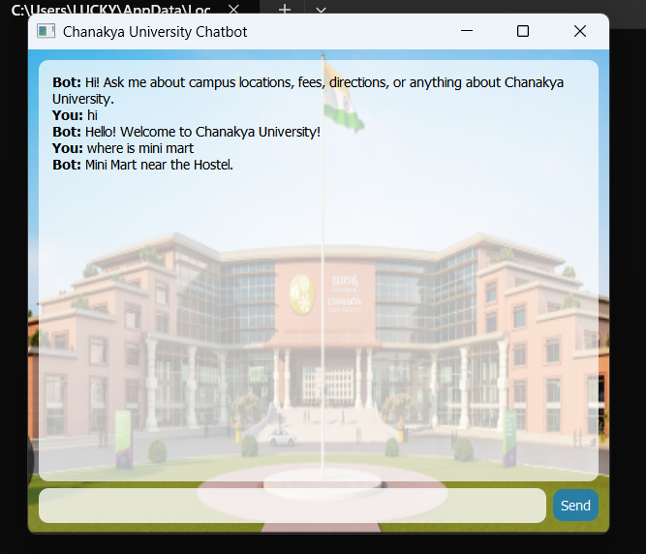
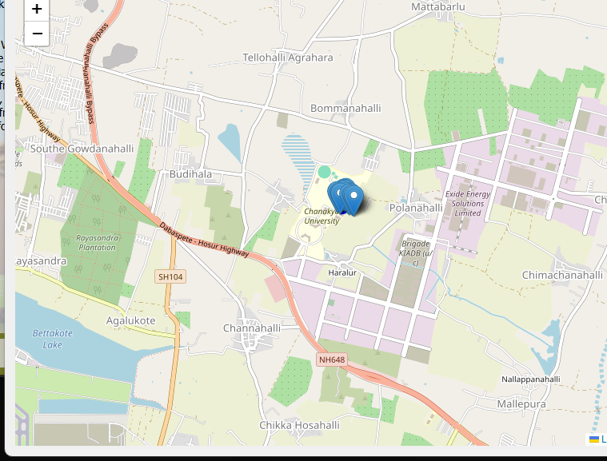
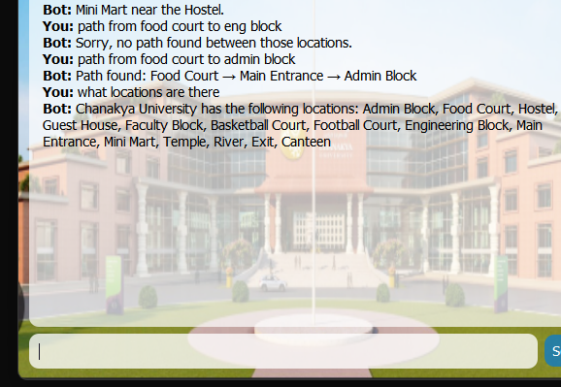
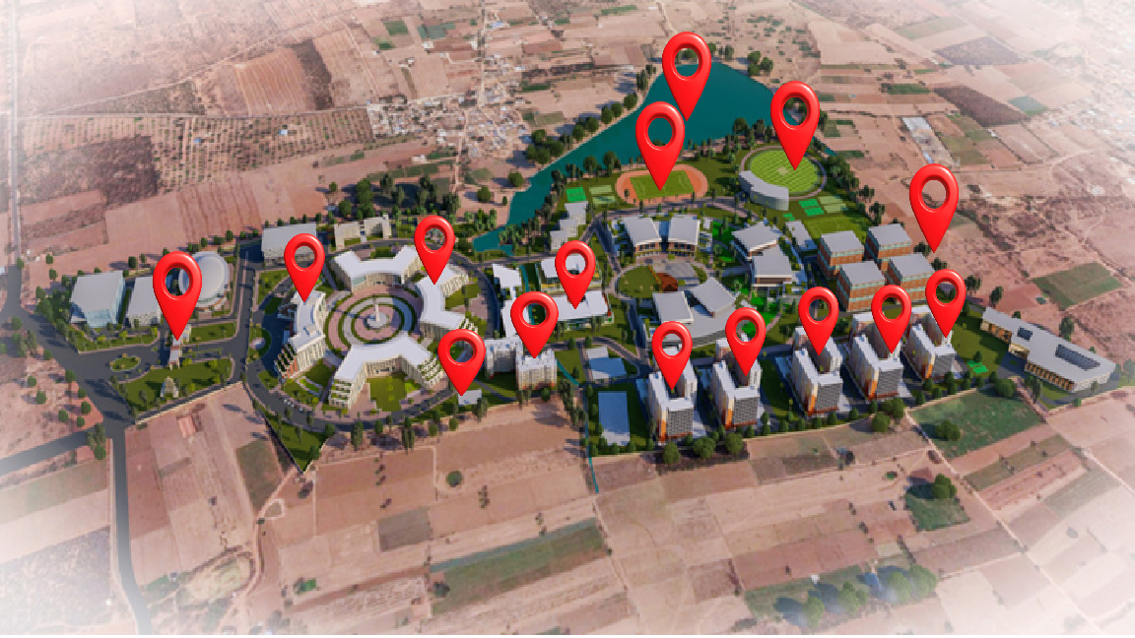
Campus modeled as a graph
BFS finds shortest path between locations
Map visualizes route and markers via Leaflet.js inside PyQt5

Slide 6


Text-based chatbot interface
Autocorrect for user input
Answers location & FAQ queries
Campus pathfinding using BFS
Interactive campus map display
Functional chatbot prototype with navigation & FAQ support
Enhances campus navigation and info access
Potential for AI/NLP improvements and mobile app integration

